Slide 1
Relations & Functions
Content
Types Of Relations
(a) Reflexive
(b) Symmetric
(c) Transitive
Equivalence Relations
Practice Questions
Types of Functions
One-one(Injective)
Onto ( Surjective)
One-One Onto ( Bijective)
Invertible Functions and Inverse of Function

Slide 2
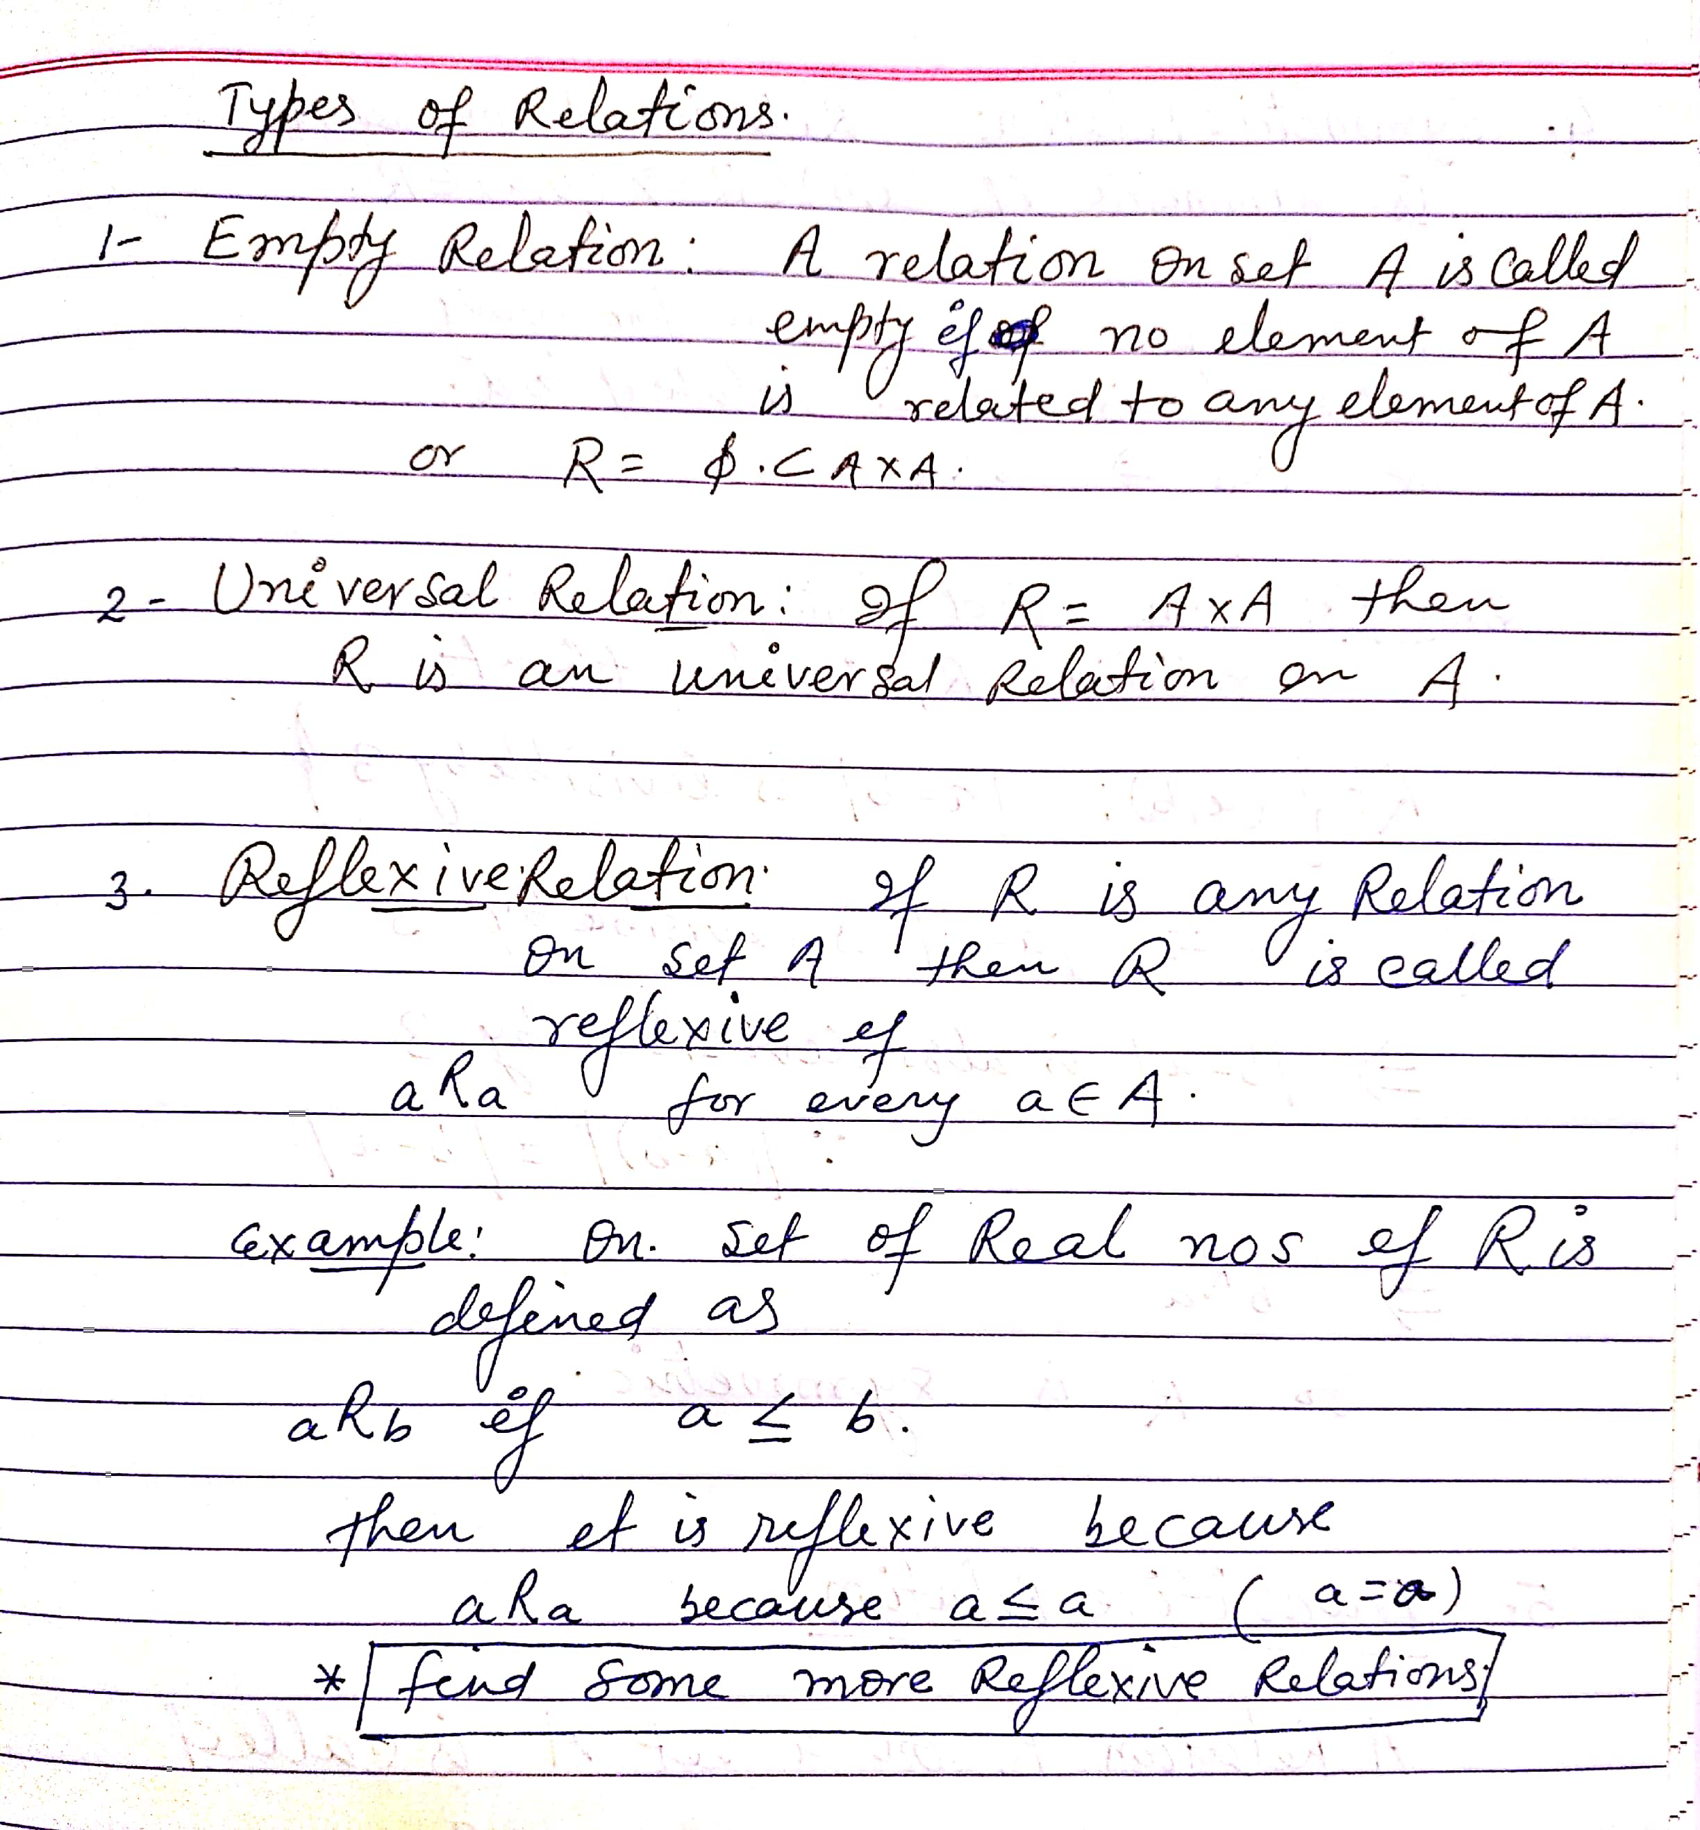
Types Of Relations

Slide 3
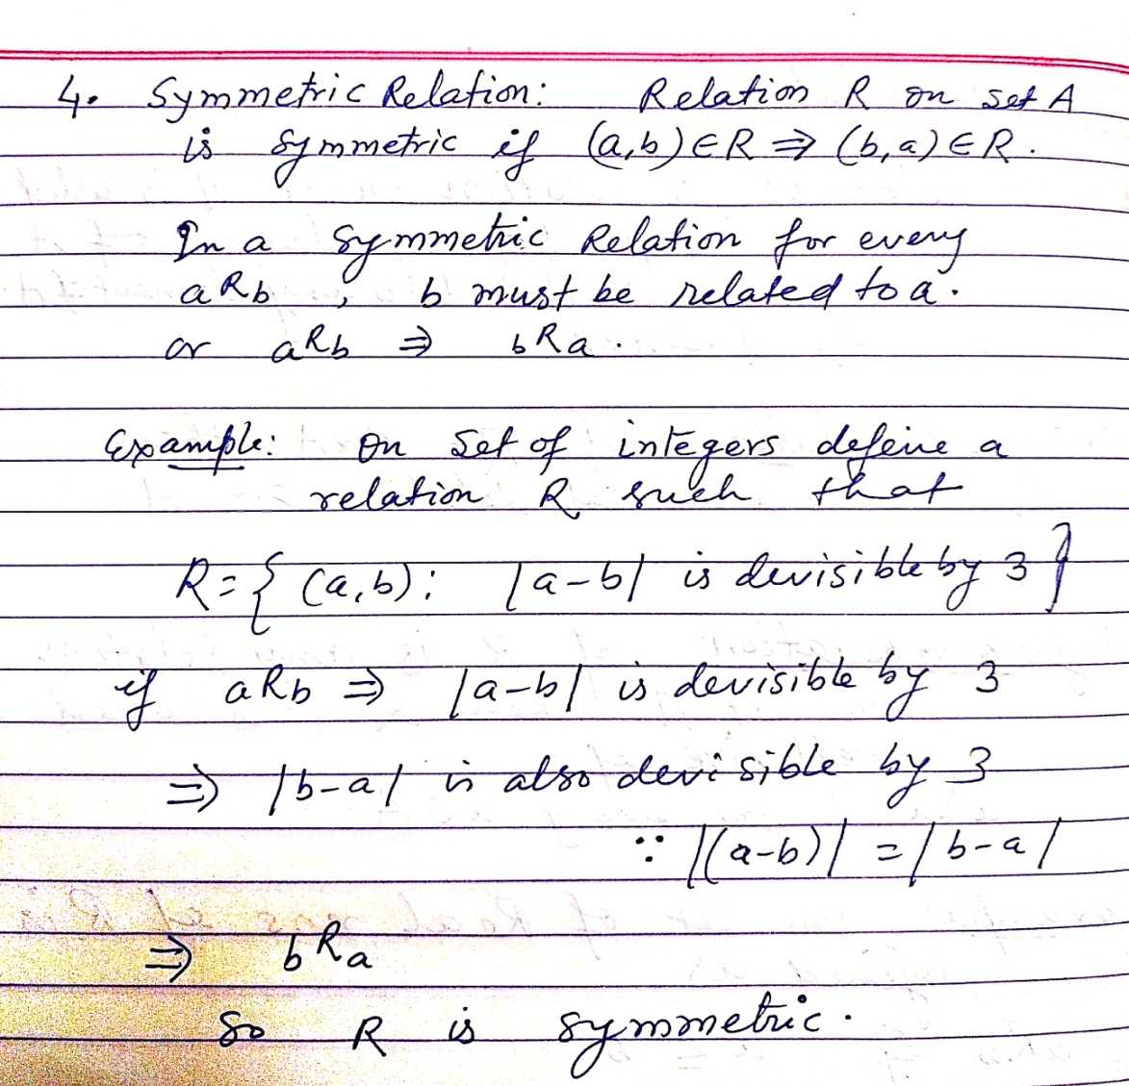
Types Of Relations

Slide 4
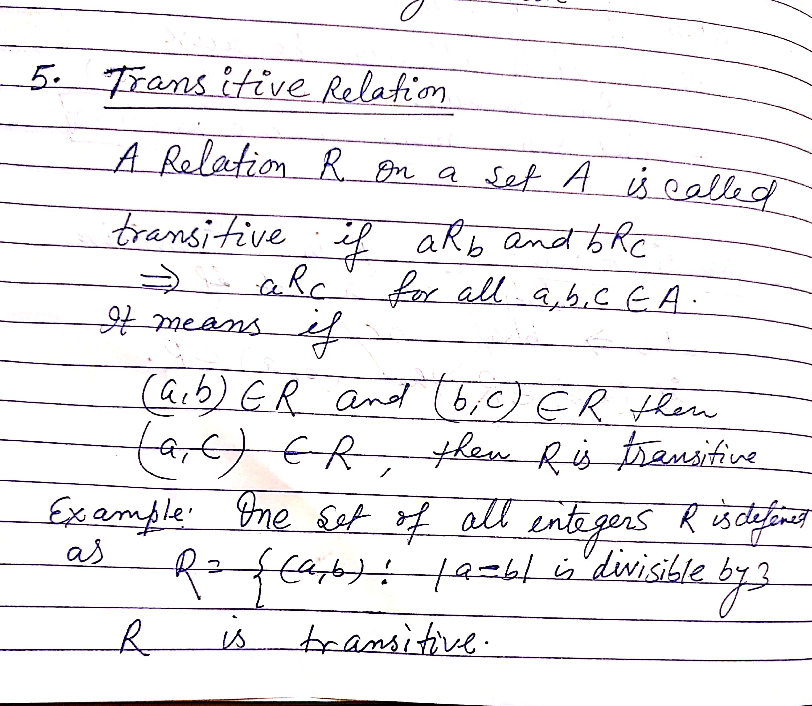
Types Of Relations

Slide 5
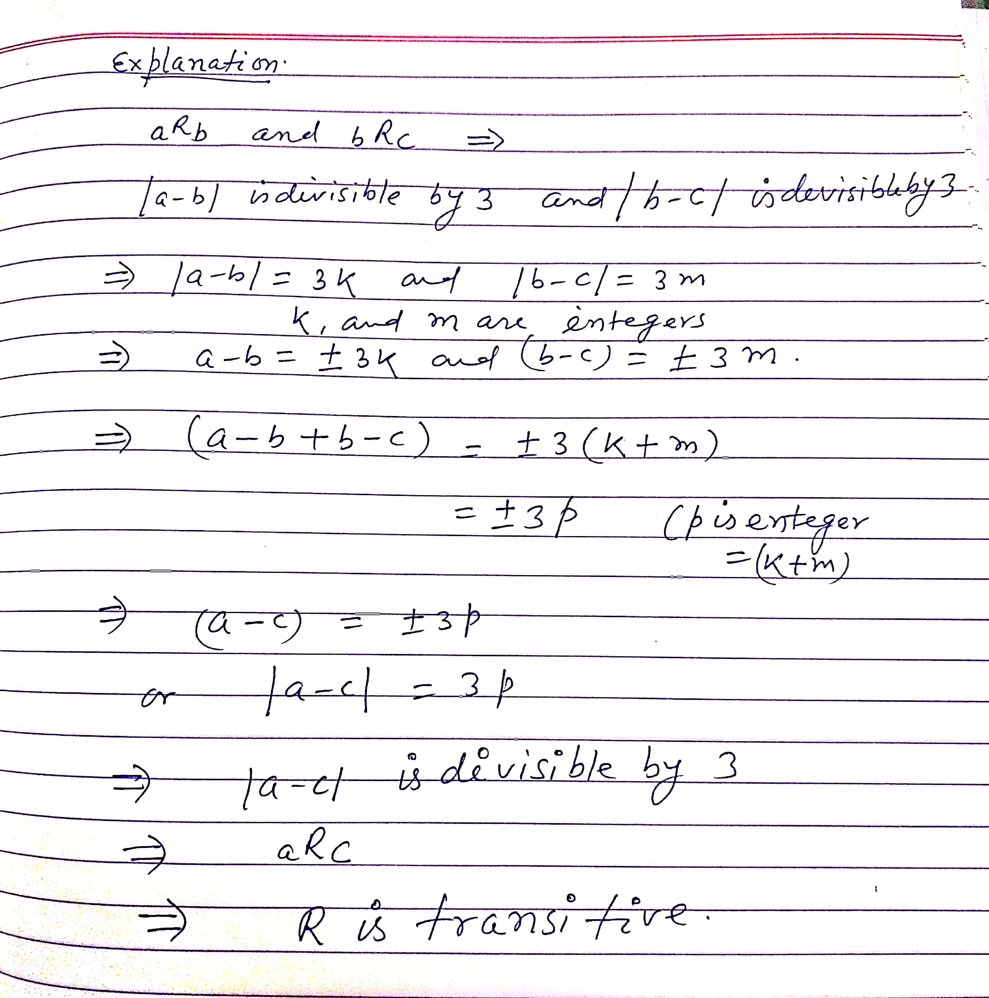
Types Of Relations

Slide 6
Equivalence Relation
A relation is called Equivalence Relation If it is Reflexive ,Symmetric & Transitive .
Example
  On the set of all straight lines in a plane the relation of parallelism is an Equivalence Relation , Defined as
  R = { ( a, b ) : a is parallel to b , a , b are straight lines in a plane }
  Verify it

Slide 7
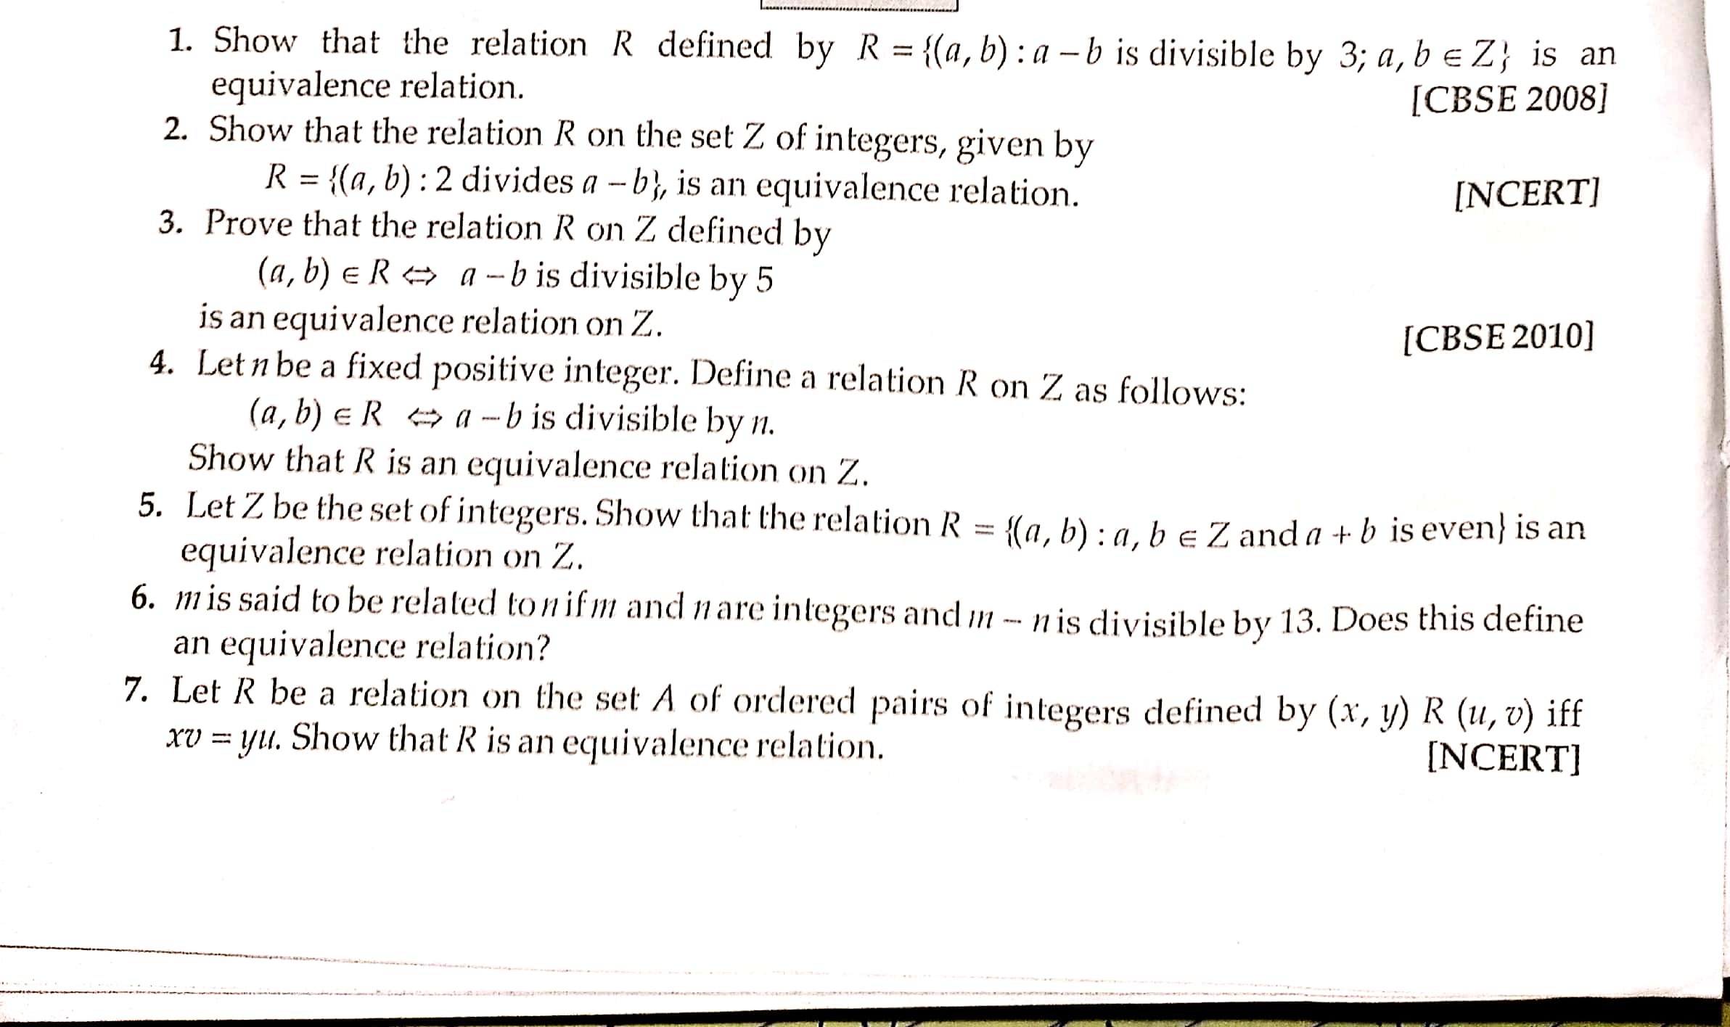
Practice QUESTIONS

Slide 8
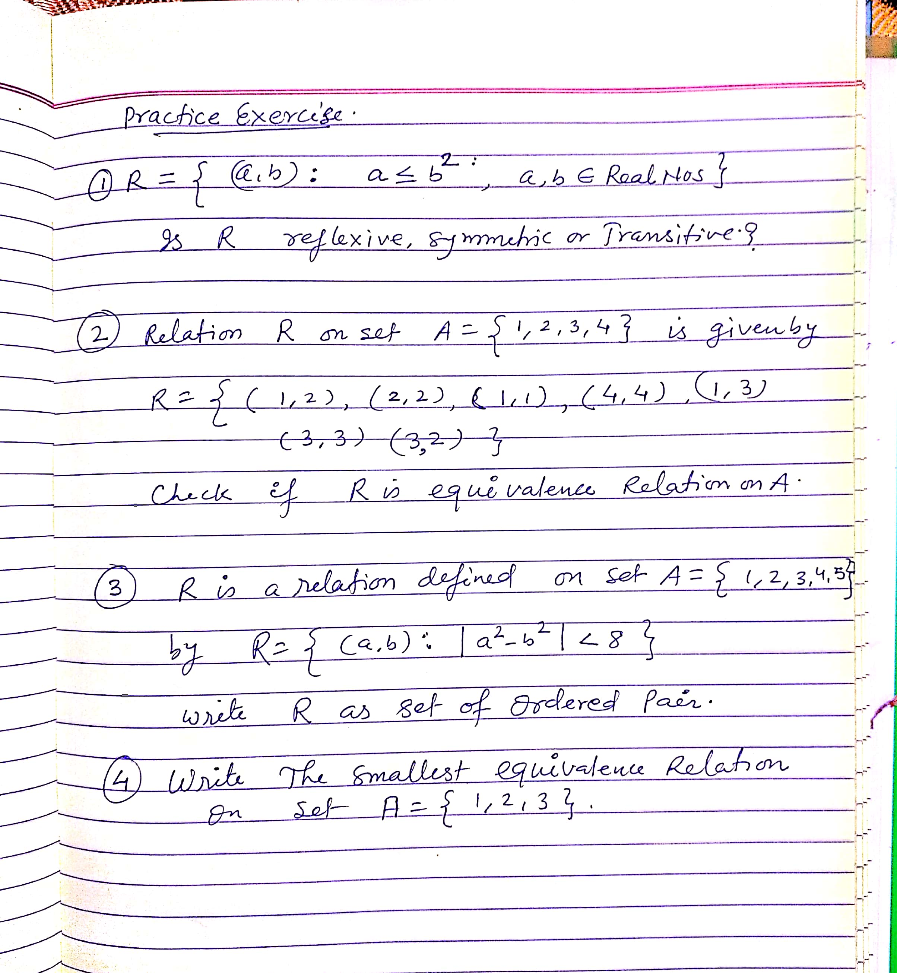
Practice QUESTIONS

Slide 9
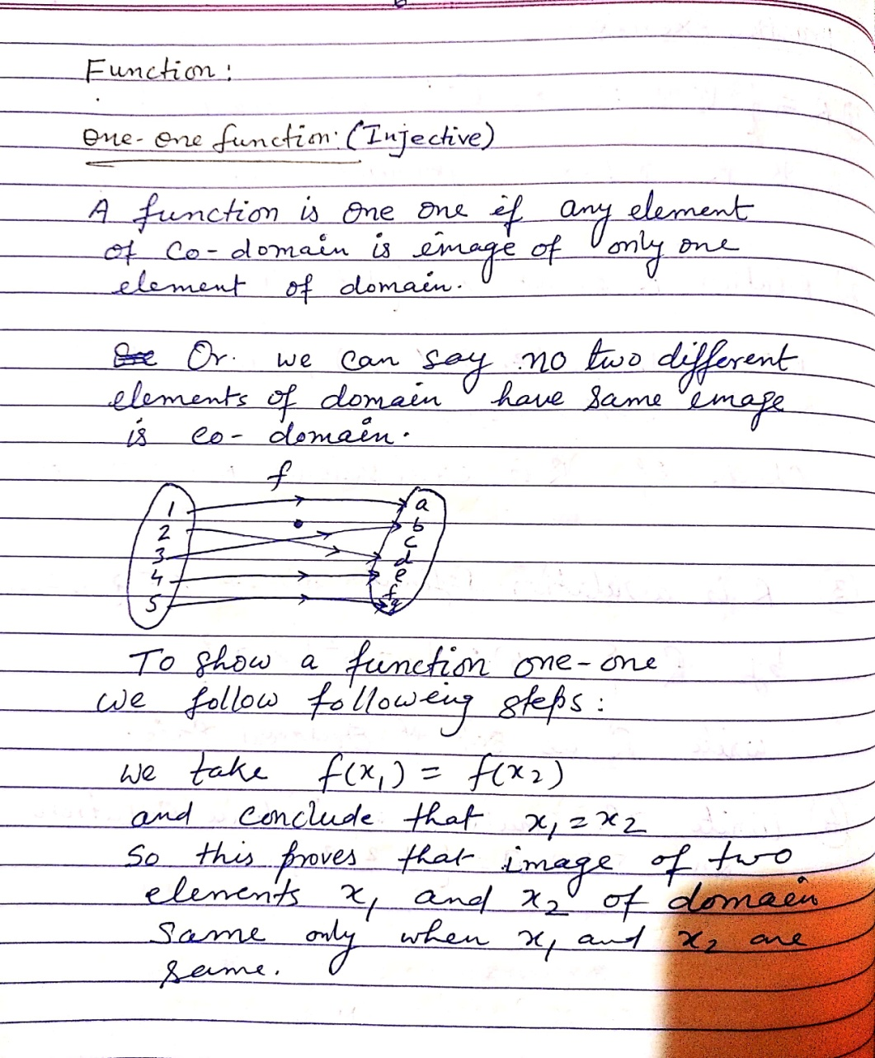
Functions

Slide 10
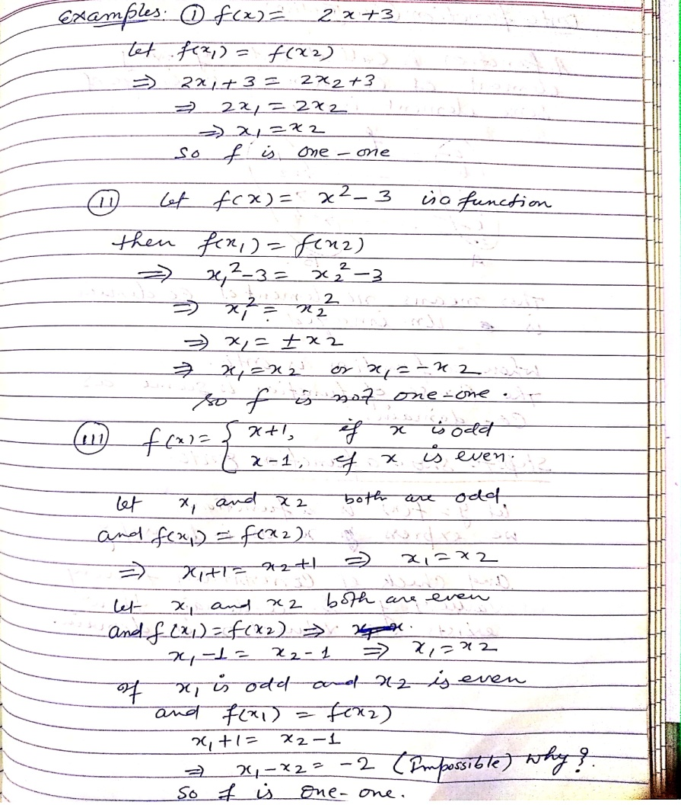
Examples

Slide 11
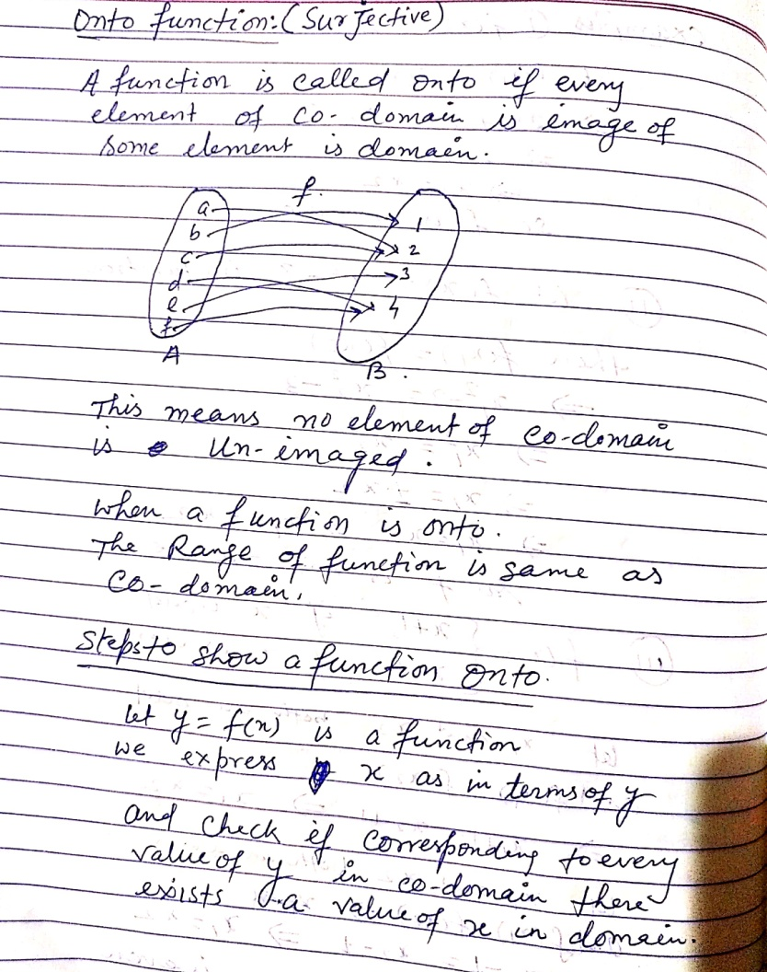
Functions : Onto

Slide 12
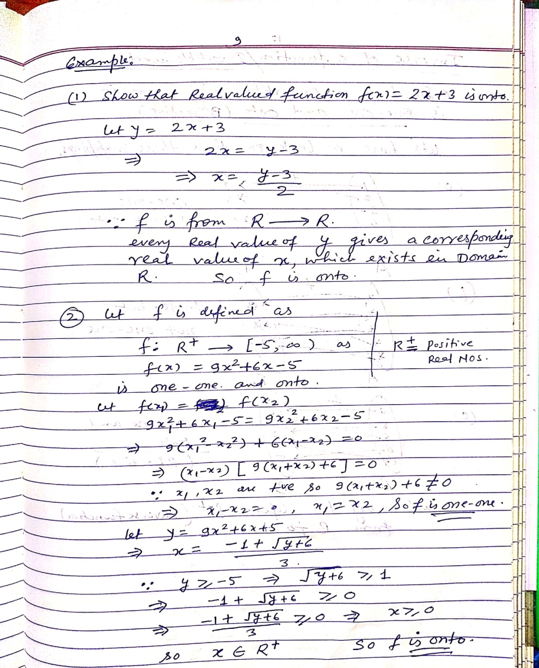
Examples

Slide 13
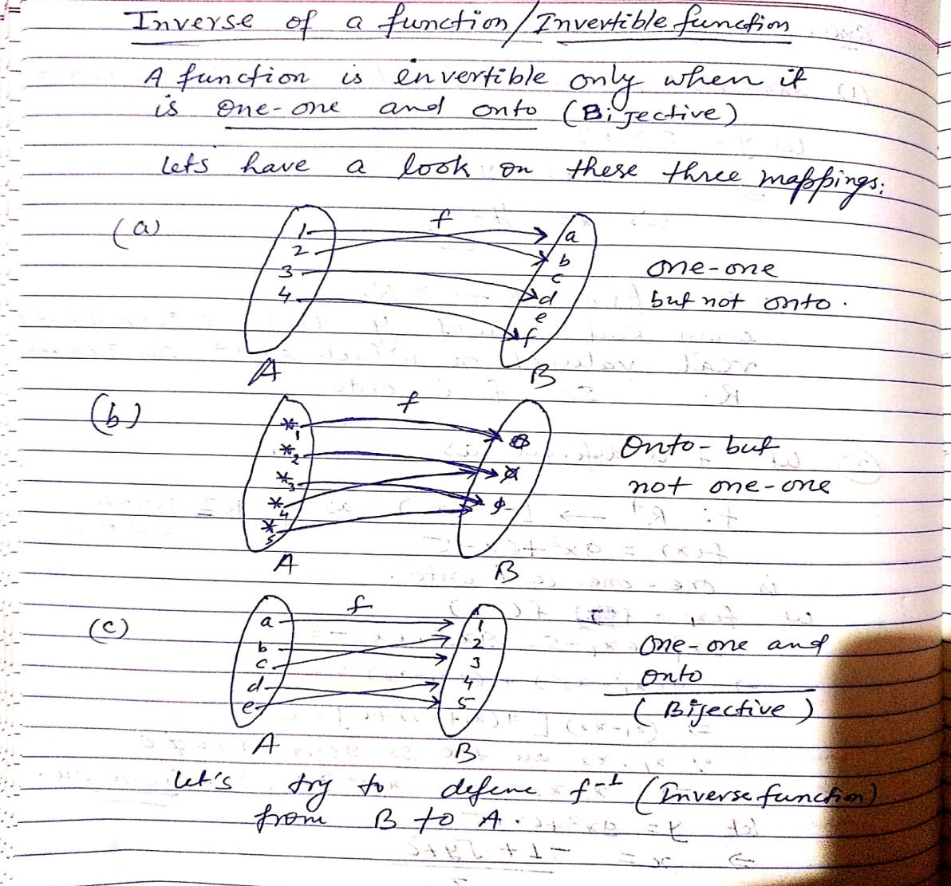
Invertible Functions / Inverse Functions

Slide 14
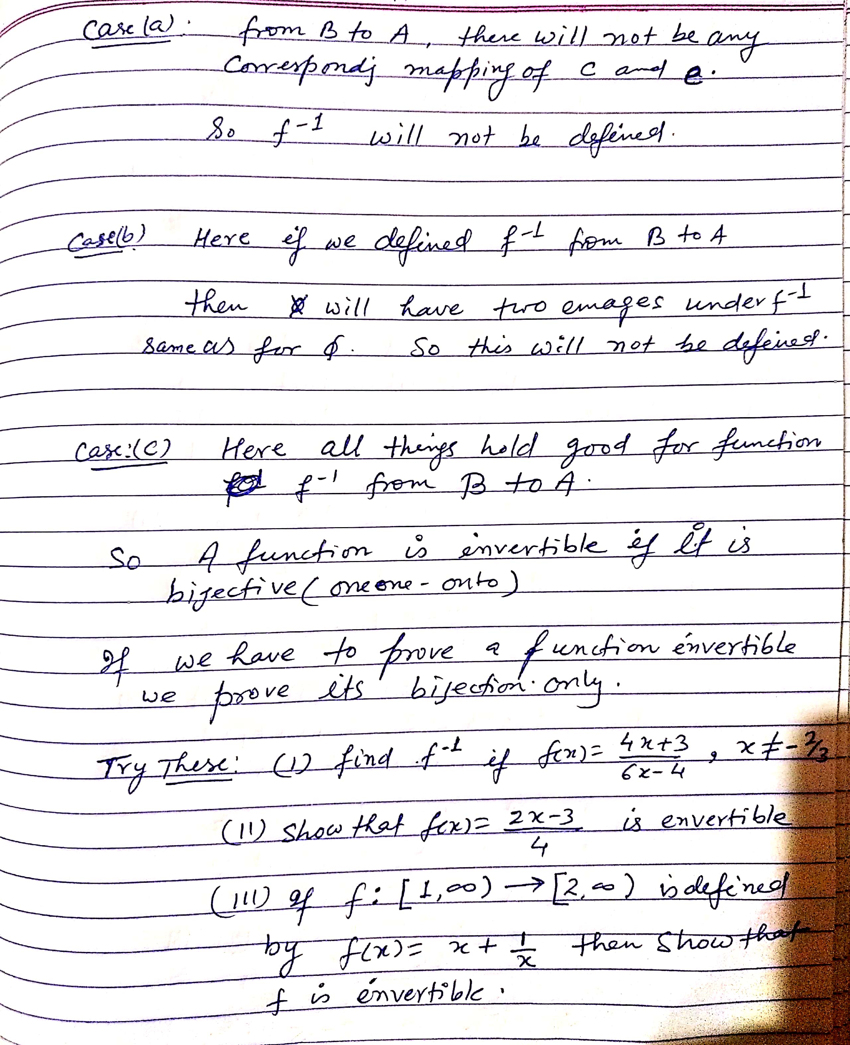
Invertible Functions / Inverse Functions

Slide 15
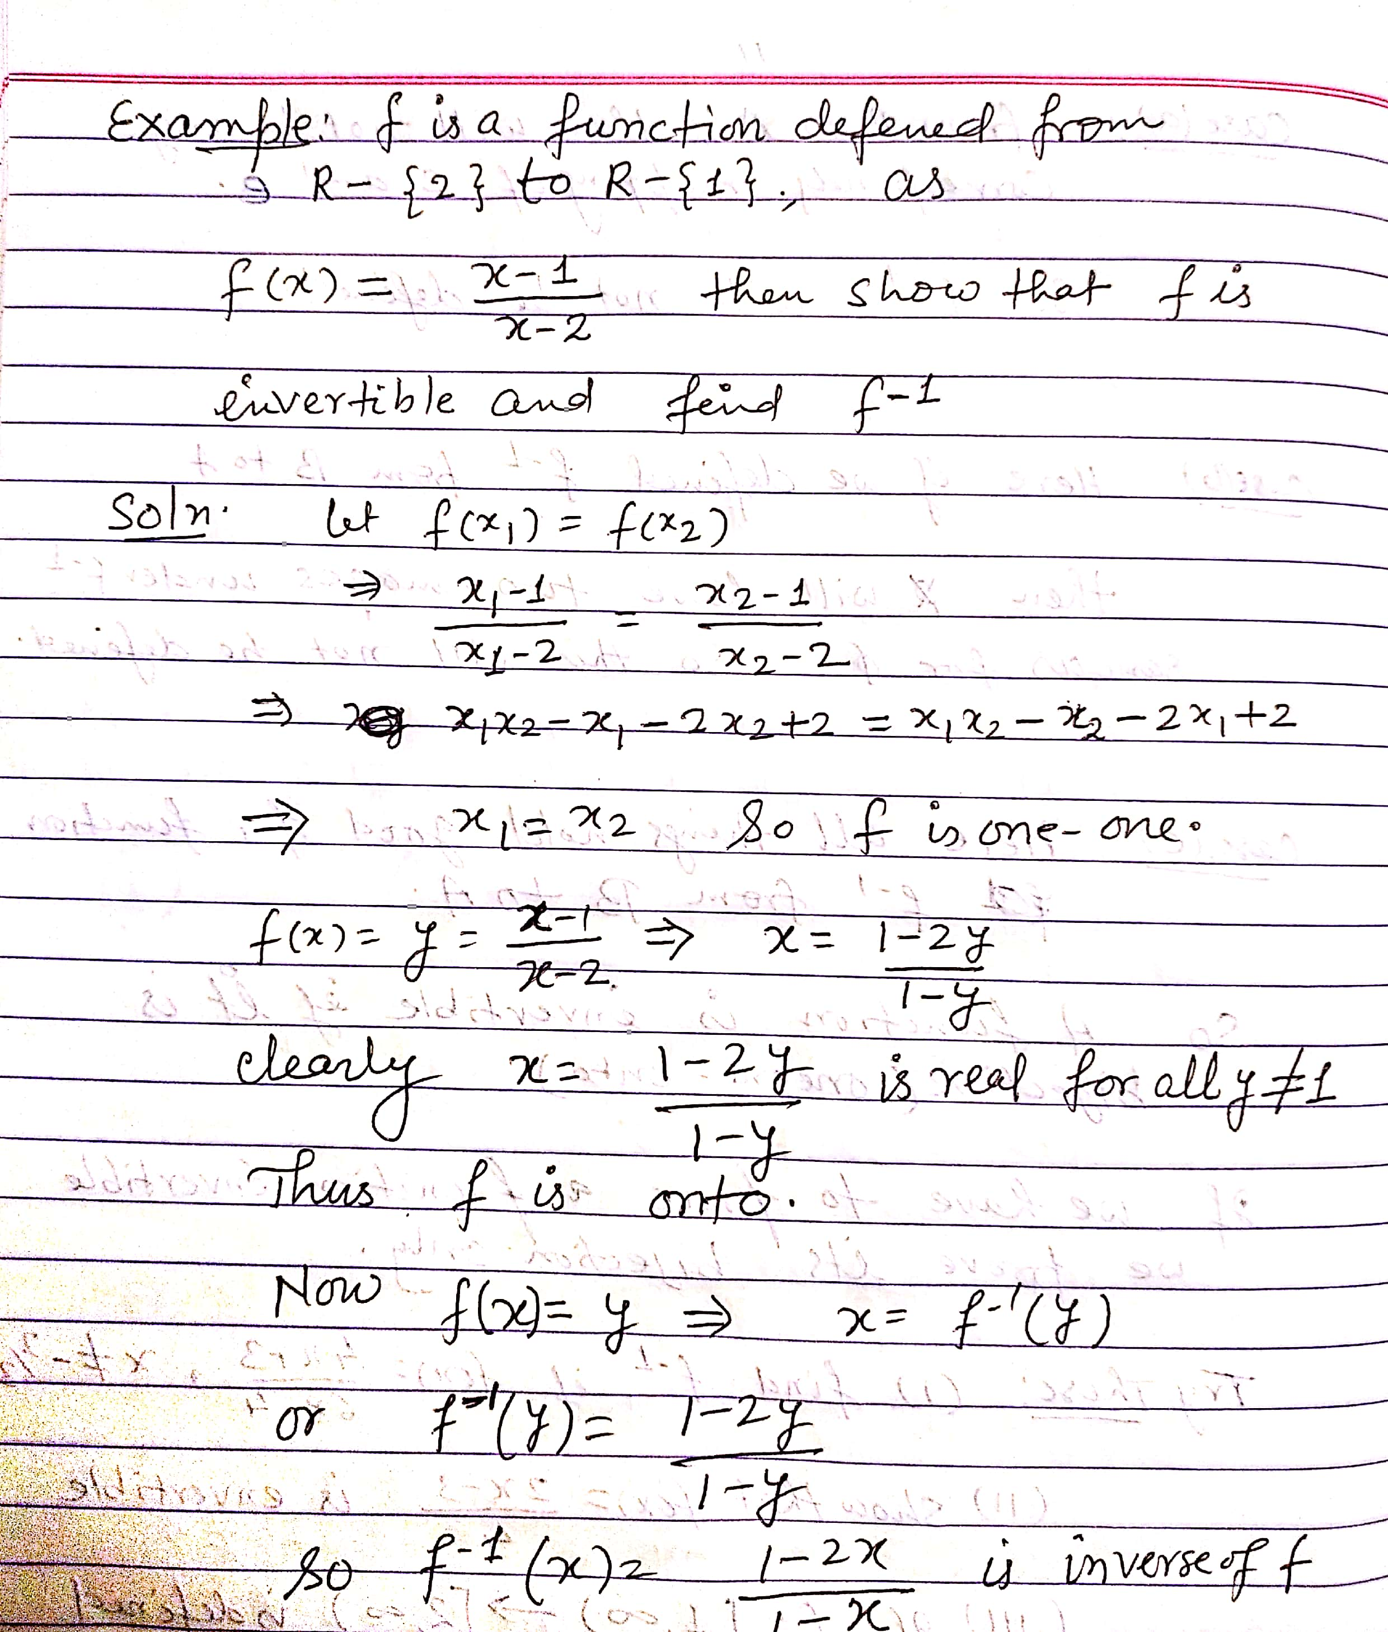
Example

Slide 16
Reference Books
1- NCERT Text Book/Exercises
2- Dhanpat Rai Publications (By R D Sharma)
3-NDA Question Bank .

